Slide 1
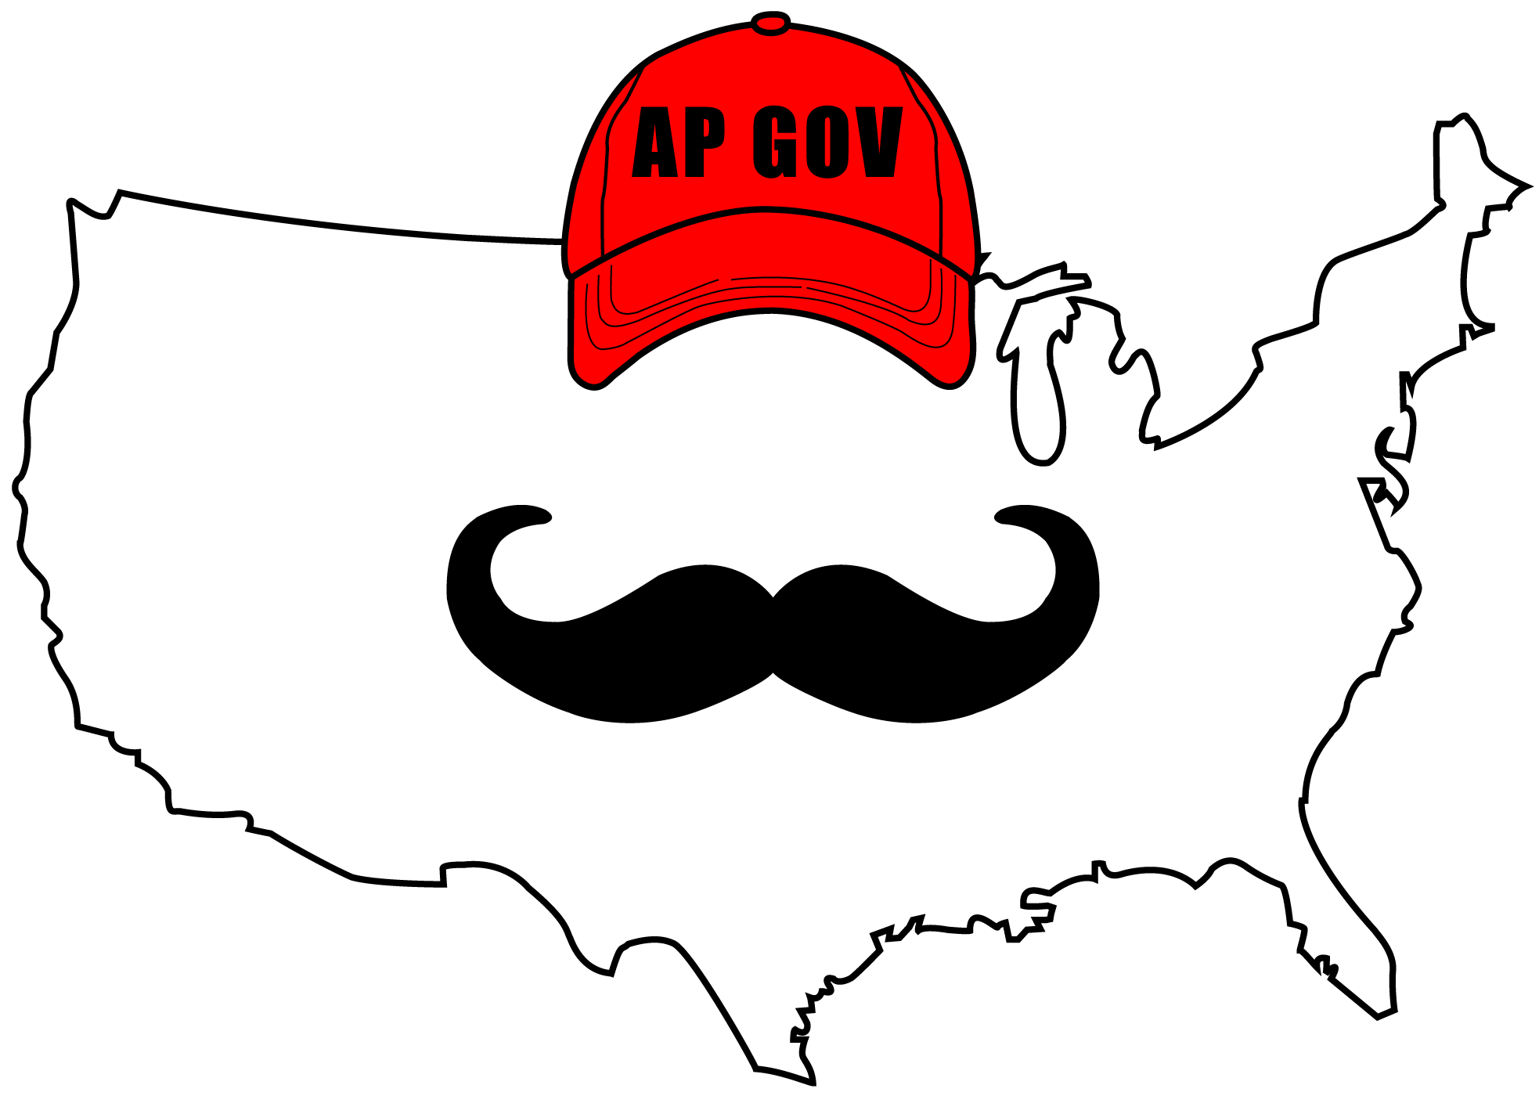
AP Gov Review, Government In America, Chapter 13
The Presidency

Slide 2

The Presidents
Great Expectations
2 mindsets about the presidency
Belief in a powerful president
Weary of central power
Who They Are
Requirements? - 35, born in US, live in US for 14 years
Prior to Obama, all white males, and Protestant (save JFK)
Backgrounds of presidents have been diverse - political scientist (Wilson), War hero (Eisenhower), Texas school teacher (LBJ)

Slide 3
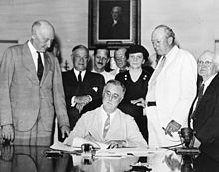
The Presidents
How They Got There
Elections: The Typical Road to the White House
4 year office term, limited to two terms after FDR, 22nd amendment
13 presidents served two or more terms
Succession and Impeachment
Nearly 1/5 of Presidents became presidents during their term as Vice President
25th Amendment - selection process for new VP if one is needed
President chooses, both houses of Congress approve by majority vote
VP takes over as President if VP and cabinet believe the president is disabled
Impeachment - bringing charges against an individual
House votes for impeachment, Senate votes to remove (2/3 vote required)
2 presidents have been impeached:
Andrew Johnson and Bill Clinton

Slide 4
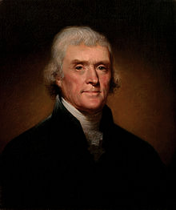
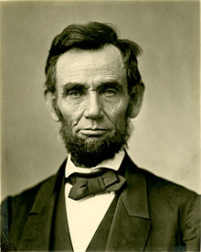
Presidential Powers
Constitutional Powers
Presidential powers are often checked by other branches
Commander in Chief - Congress declares war
Appoint cabinet and officials - approved by Senate
President can:
Veto bills, call Congress to special sessions (check on legislative branch)
Grant pardons and nominate judges (check on judicial branch)
The Expansion of Power
By increasing presidential responsibilities, presidential power has increased
Jefferson and LA Purchase, Lincoln and Civil War, FDR and economy, etc
Perspectives on Presidential Power
American views of the presidency drastically changed in the 1960s and 1970s:
Vietnam War and Watergate

Slide 5
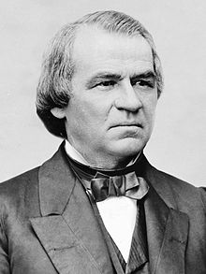
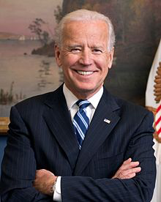
Running the Gov.: The Chief Executive
The Vice President
Over time, the choice of Vice Presidents has been much more important - balancing a ticket
Constitution states they vote in case of a tie in the Senate
Many recent VPs have had connections to Washington - H.W. Bush, Gore, Biden - and advise the president
The Cabinet
Not mentioned in the Constitution
Washington’s cabinet - War (Knox), State (Jefferson), Treasury (Hamilton)
14 cabinet departments today + Attorney General
Cabinet heads must be approved by Senate

Slide 6
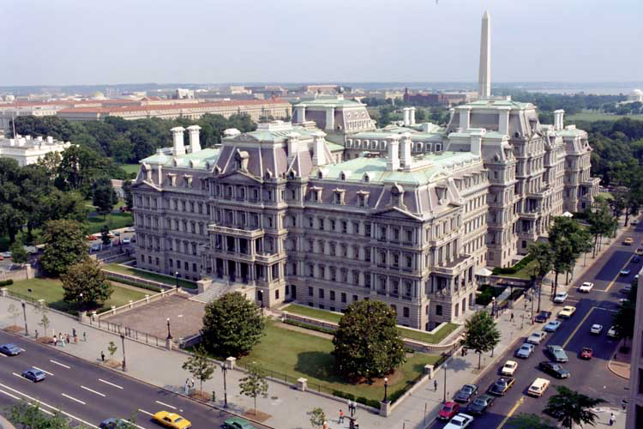
Running the Gov.: The Chief Executive
The Executive Office
Created in 1939 by FDR
National Security Council - foreign policy and military advisers
Makes foreign policy and national security recommendations
Council of Economic Advisers - 3 members that advise the president about economic policy
Office of Management and Budget - helps prepares the president’s budget (next chapter)

Slide 7
Running the Gov.: The Chief Executive
The White House Staff
600 people with a wide range of jobs - travel plans, respond to letters, etc.
Chief of Staff, Press Secretary, and National Security Assistant interact with the president daily and are often important confidants of the President
Hierarchical organization: (Most common)
Chief of Staff at the top, overseeing all underneath
Wheel-and-spokes:
Aides have equal status and take part in decision making
The First Lady
Abigail Adams and Dolley Madison advised their husbands
Eleanor Roosevelt (“eyes and ears” of FDR) - pushed for New Deal policies
Hillary Rodham Clinton played a large role in Bill’s administration - pushed for national health care

Slide 8
Presidential Leadership of Congress: The Politics of Shared Powers
Chief Legislator
President can do one of three things with a bill:
Veto, sign, nothing and it becomes law after 10 days
If Congress adjourns within 10 days, the president can do nothing and the bill will die (pocket veto)
Threat of a veto is very powerful in shaping legislation
Unlike many governors, the president does NOT have a line-item veto
Party Leadership
The Bonds of Party
The president is often “united” with Congress members of the same political party
For the most part, they agree on much of the same policy

Slide 9
Presidential Leadership of Congress: The Politics of Shared Powers
Party Leadership
Slippage in Party Support
Controversial issues may divide party consensus
If there is a gap between constituents and the president, Congress members often side with constituents
Leading the Party
President is the leader of the political party
President can support a campaign, take pictures with Congress members, etc.
Presidential coattails - Congress members of president’s party receive a high number of votes due to support of president
Less of an impact over time
Midterm elections often hurt Congress members of the president’s political party

Slide 10
Presidential Leadership of Congress: The Politics of Shared Powers
Public Support
Public Approval
High presidential approval = more legislation the president favors
Low presidential approval = increased resistance from opposing party
Mandates
Electoral Mandate - presidential victory can be interpreted as supporting the president’s policies
Election of 1932 - how the government should respond to the Depression
Election of 1980 - big government was on trial

Slide 11
Presidential Leadership of Congress: The Politics of Shared Powers
Legislative Skills
To gain support for legislation, bargaining is paramount
Congress members are often given incentives - subsidies to constituents, etc. to gain support

Slide 12
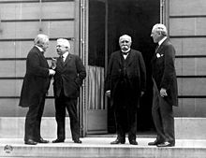
The President and National Security Policy
Chief Diplomat
President can recognize foreign governments
Negotiates treaties - approval by Senate
Executive Agreements - agreements with foreign countries - not subject to Congressional approval
SALT I
Commander in Chief
Leader of more than 1 million troops
“Nuclear football”

Slide 13
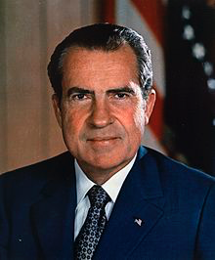
The President and National Security Policy
War Powers
Congress has NOT declared war since WWII
War Powers Resolution - limited the power of the president during war
President must consult with Congress before using the military
Must withdraw troops within 60 days unless Congress approves of extension
Mores symbolic than anything
During times of war or crisis, presidential powers expand
NSA’s spying without warrants

Slide 14
The President and National Security Policy
Crisis Manager
Crises often define a president’s image and administration
Early on crises were not as immediate
Working with Congress
Congress can refuse funding for presidential decisions
The president is often more successful with Congress on foreign policy issues than domestic

Slide 15
Power from the People: The Public Presidency
Going Public
Many presidents go public to spread their ideas/give important messages
Presidential Approval
Often approval is around %50
Often partisan - party not in power often does not approve
Approval ratings often linked to economy, foreign affairs, etc.
Prosperous economy often means a favorable approval rating

Slide 16
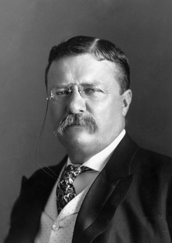
Power from the People: The Public Presidency
Policy Support
Bully Pulpit - presidents can influence public support
Popularized by TR
Misinformed public can have a hard time evaluating policies
Most Americans believed Iraq played a role in 9/11 attacks
Mobilizing the Public
Often the president will appeal to the public to ask Congress for support of policies
Not always successful, but Reagan’s appeal for tax cuts seemed to help

Slide 17
The President and the Press
Press Secretary:
Direct link between the president and press
Meet with the press on a daily basis
Answer ?s/explain decisions
Prime-time press conferences are rare in recent years
Bias - holding a preference/point of view towards an issue/person/political party
News is often accused of being biased
The media can help define a president’s image
President Ford
Sean Spicer

Slide 18
Understanding the American Presidency
The Presidency and Democracy
Opponents of presidential policies often point to a fear of too much presidential power
The Presidency and the Scope of Government
Succeeding presidents often have differing views on the size of federal government
LBJ -> Nixon
George W. Bush -> Obama

Slide 19
Quick Recap
Impeachment - what it is and isn't
Presidential powers - Commander in Chief, appoints officials, vetoes bills, grant pardons
1960s - 1970s distrust of presidency
Presidential Cabinet
Office of Management and Budget (OMB)
First Lady
Chief Legislator
Chief Diplomat
Election mandates
War Powers Resolution
Bully Pulpit
Press Secretary

Slide 20
See You Back Here For Chapter 14!
Thanks for watching
Best of luck this year

